Slide 1

Builder DP
By: Mahmoud ibrahim

Slide 2
What is Builder
Builder DP is a Creational Design Pattern
Used to build complex Objects
Used for objects in which creation of the parts is separated from the hall

Slide 3
When to Use Builder?
Very complex objects
Different parts for final product
parts must be separated from the hall

Slide 4
Advantages
Encapsulation
Hide internal code from the client
parts must be separated from the hall

Slide 5
Disadvamtages
Duplicated code
Client must know many classes
Use of composition

Slide 6
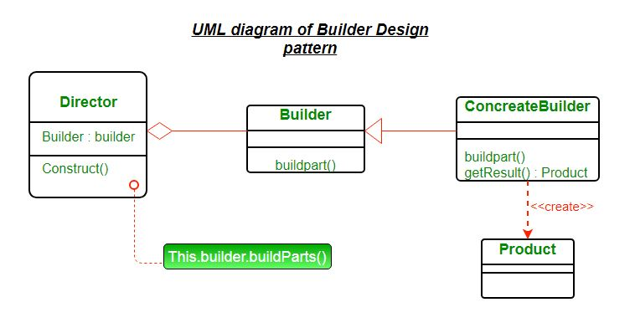
UML

